Slide 1

DATA VISUALISATIONS:EMPOWERING BUSSINESS WITH EFFECTIVE ISIGHTS
jAYASRI

Slide 2
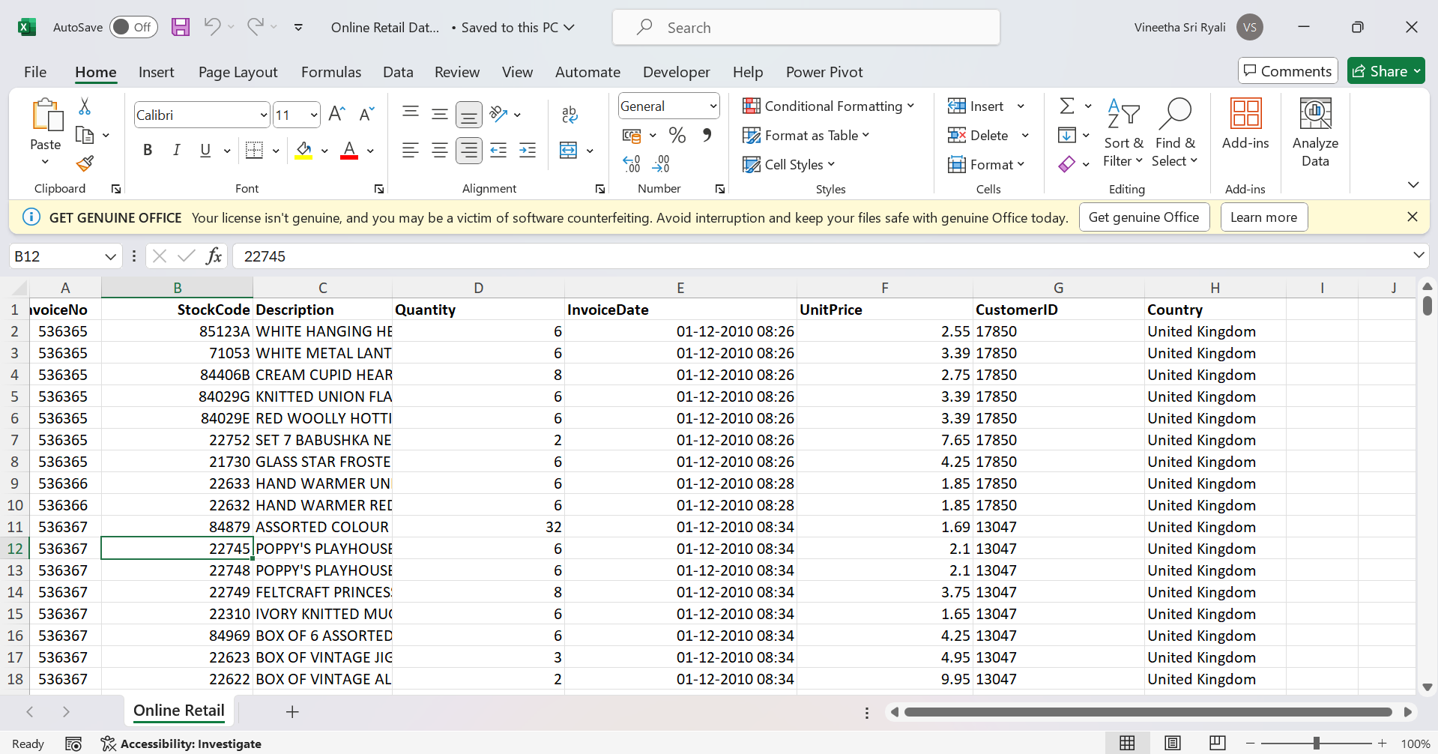

Slide 3
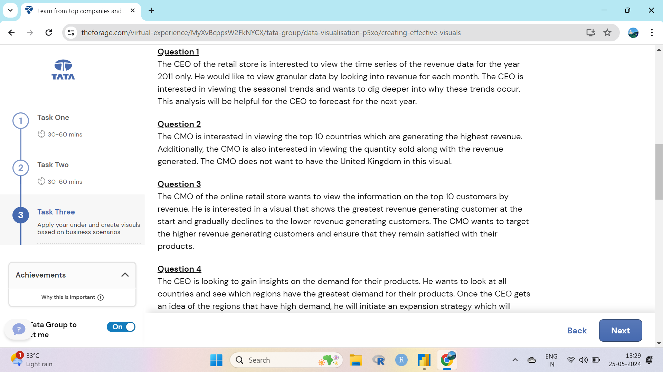

Slide 4
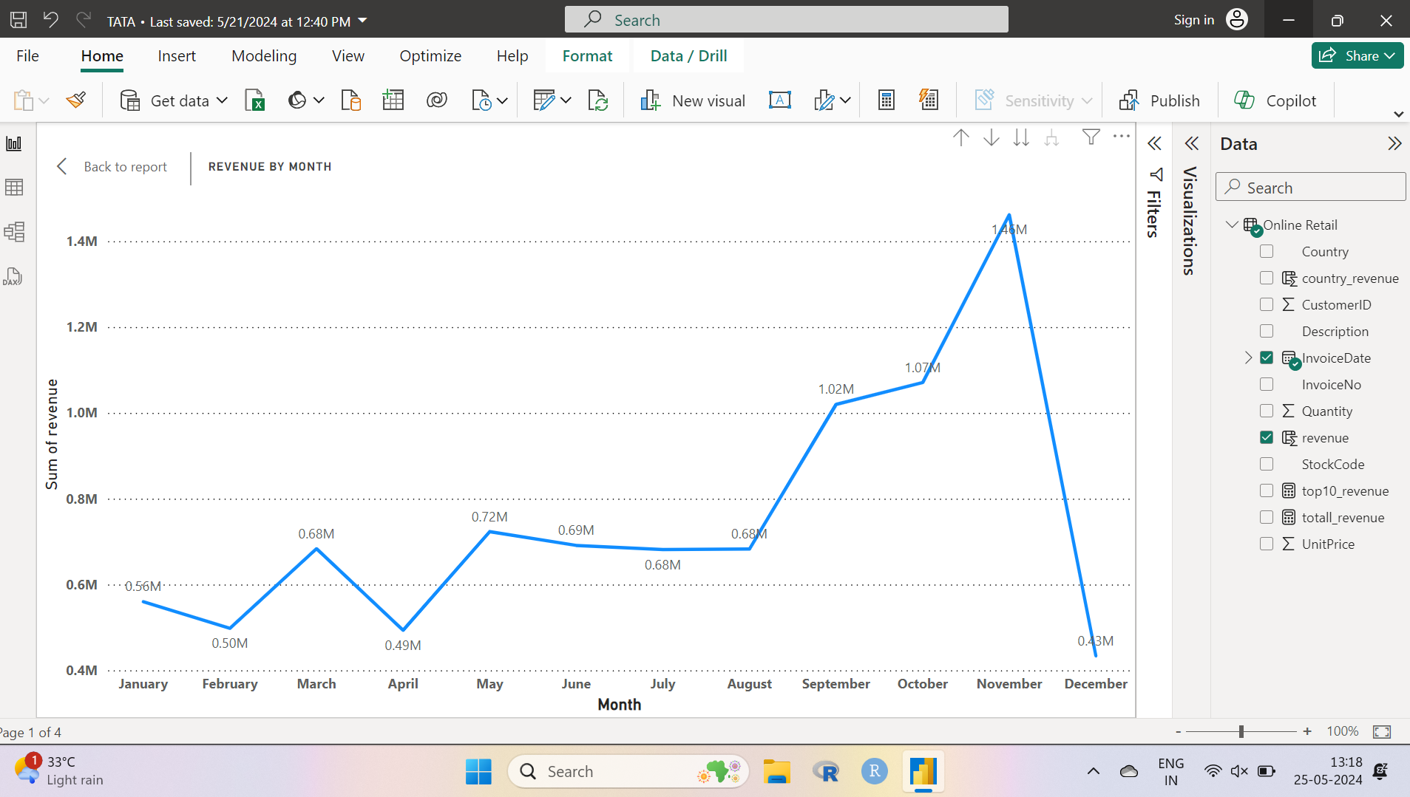

Slide 5
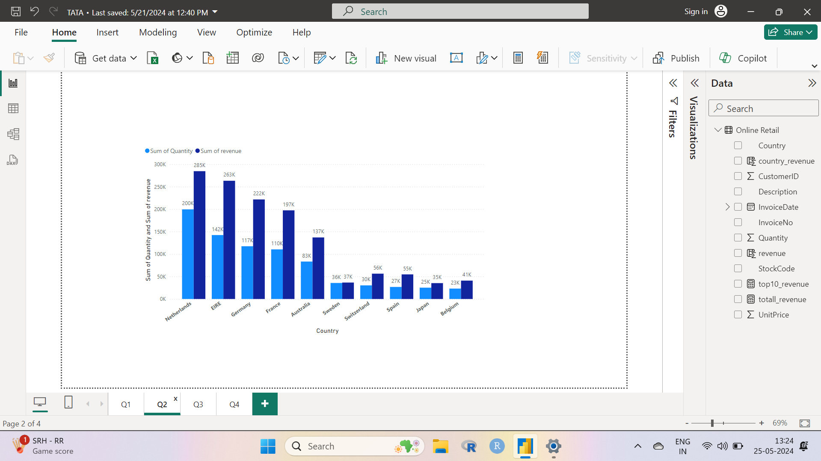

Slide 6
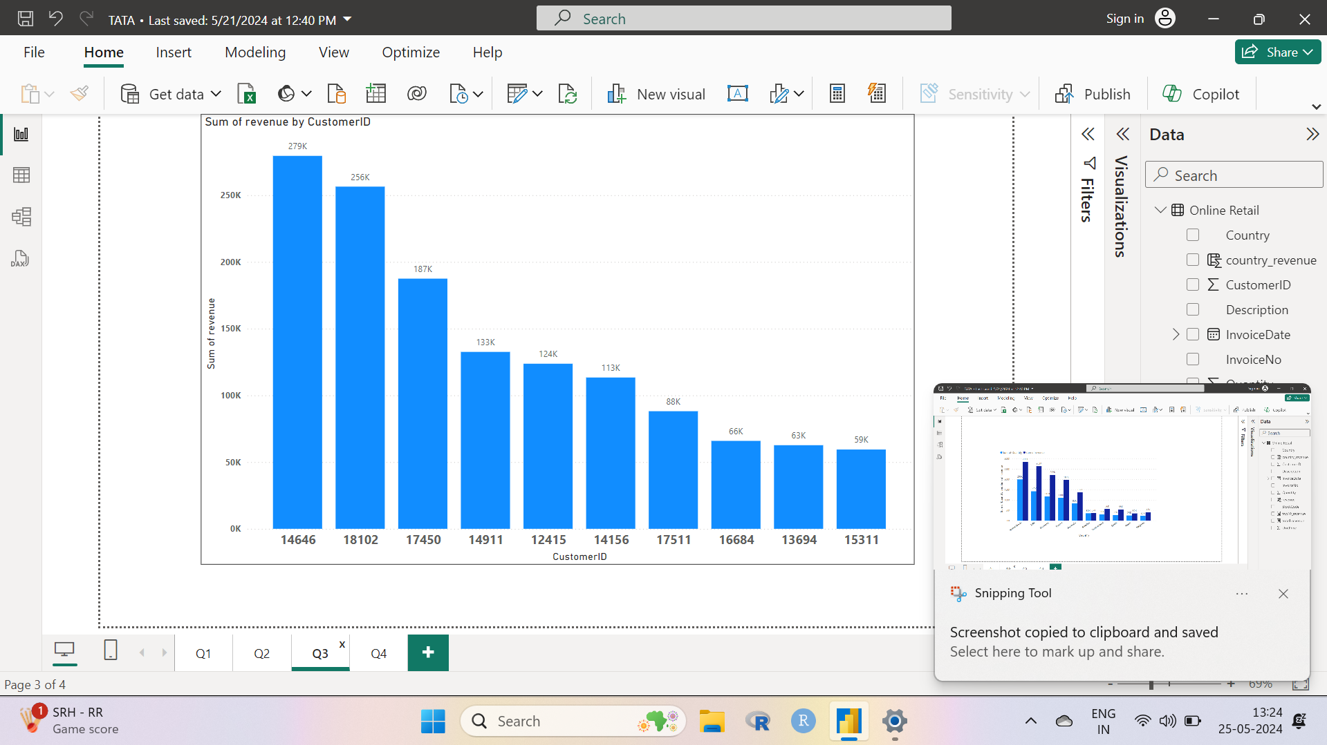

Slide 7
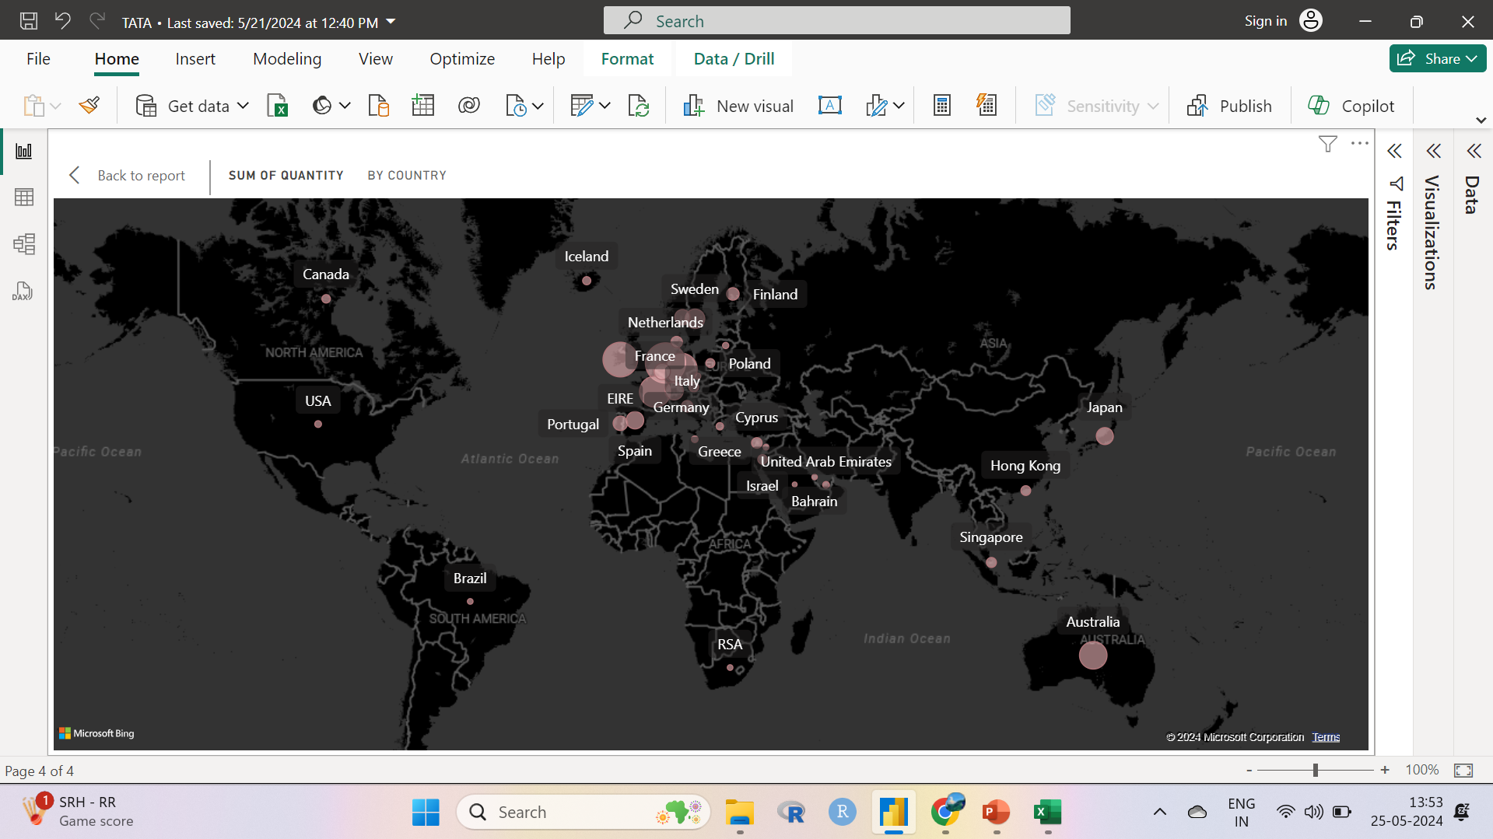

Slide 8
Insights
The company should come up with the strategies that aim at stocking and advertising seasonal products to maximise sales when the demand go up
The company should create a special relationship with the customers who order in big quantities in order to increase the retention of the customers by giving some discounts and offers.
European market has more potential to gross sales hence the company should build strategies to maximise the sales .

Slide 9
THANK YOU
-R.JAYASRI

